Slide 1
BUNDLING
MGCR 293
Professors: Dr. K. Salmasi
Dr. Taweewan Sidthidet
Dr. Tariq Nizami
T.A.: Mike Brintnell
Presentation Credit: Brianna Mooney

Slide 2
CHAPTER REVIEW

Slide 3
Definitions
Separate Selling: a company sells each product separately
Pure Bundling: when a company offers several products or services as one package. You cannot purchase the products or services individually
Mixed Bundling: allow consumers to purchase packaged products or services as a single package, or individually

Slide 4
Definitions Cont.
Negative correlation: some consumers have higher reservation prices for one item in the bundle but lower reservation prices for another item in the bundle, and another group of consumer has the opposite preferences
Managers leverage consumers’ negative correlations in order to increase profit by creating bundles

Slide 5
Bundling – General Results
When production cost is low, pure bundling is the most profitable (all consumer surplus is extracted by the company)
When production cost rises, mixed bundling is most profitable
When production cost rises further, separate pricing is most profitable

Slide 6
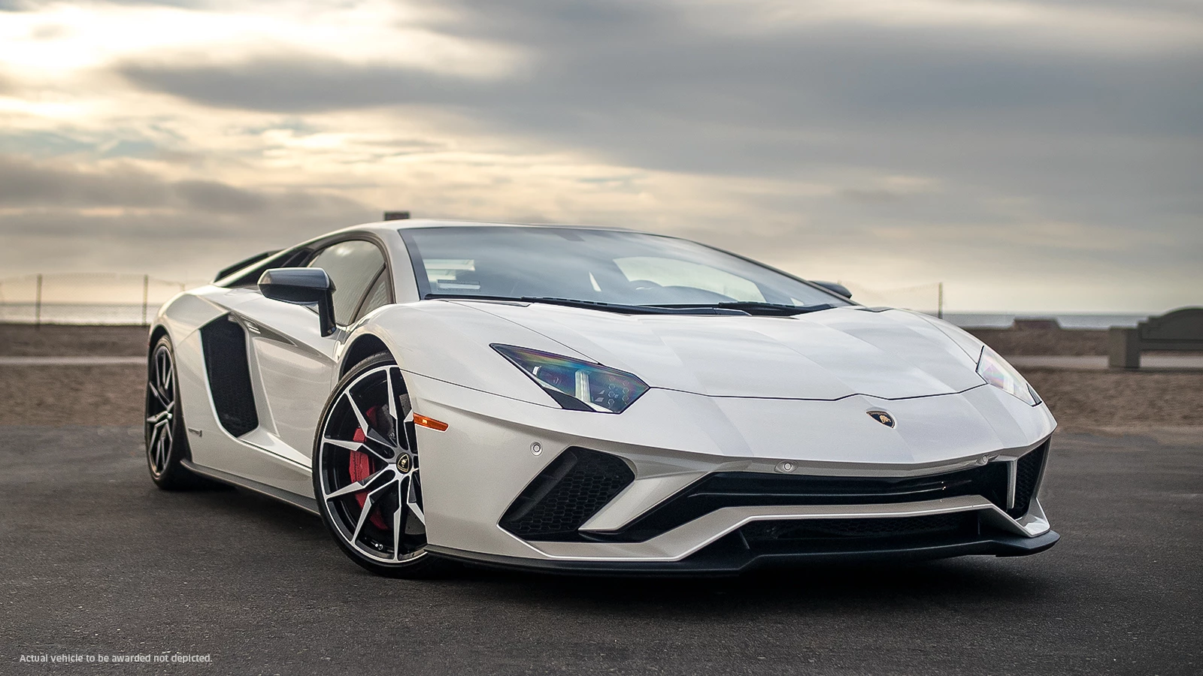
Tying
Managers sell products that need a complimentary product. It ensures that the product works properly and protects brand name.

Slide 7
Intra-Firm Pricing
Firms often have more than one division (e.g. production and marketing are two different divisions)
The production division (the upstream division) produces the upstream product and sells it to the marketing division (the downstream division).
We need to determine what price the production division is going to sell the product to the marketing division at. There are two options (next two slides)

Slide 8
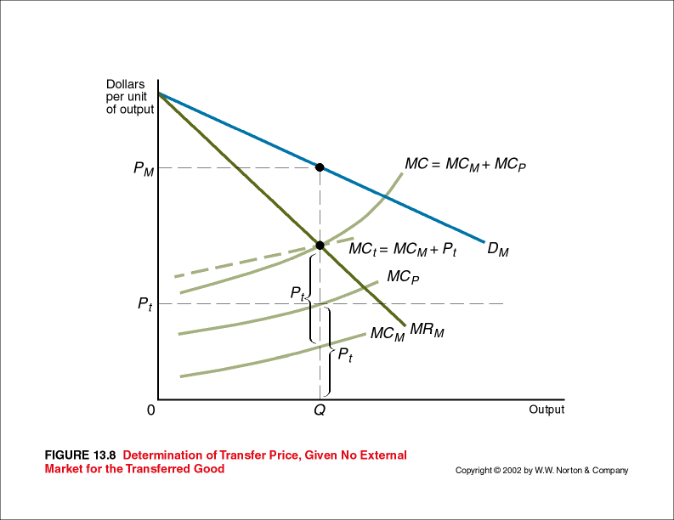
Intra-Firm Pricing – Option 1
No External Market:
MR_{M}=MC_{M}+MC_{P}
Transfer Price=MC_{P}=MC of Prod. Division

Slide 9
Intra-Firm Pricing – Option 2
Perfectly Competitive External Market:
Production:
P=MC_{P}
Marketing:
MR_{M}=MC_{M}+P
P=Transfer Price=Perfectly comp. mkt price

Slide 10
A few words of advice...
Look at all of the reservation prices; notice where they are unusually high and low
The optimal separate prices are always equal to consumers' reservation prices.
The optimal pure bundle price is always equal to the sum of consumers' reservation prices.
The optimal mixed bundle prices are not necessarily equal to reservation prices or their sum.
With mixed bundling, you must sell at least one unit of one of the products separately

Slide 11
CHAPTER QUESTIONS

Slide 12
Question 1
Marketing division and a production division.
The marginal cost of the firm’s upstream product is $10 per unit
The marginal cost of marketing it is $4 per unit.
The demand curve for the firm’s product is P=100 – 0.01Q.
There is no external market for the good made by the production division.

Slide 13
Question 1
How should managers set the optimal output?
What price should managers charge?
How much should the production division manager charge his counterpart in marketing for each unit of the product?

Slide 14
Answer
a) MR=MC
MC=MC₁+MC₂=4 + 10=$14
TR=100Q – 0.01Q²
MR=100 – 0.02Q
100 – 0.02Q=14
Q=4300
b) P=100 – 0.01(4300)= $57
c) Transfer price =MC_{p}=10

Slide 15
Question 2
Marketing division and a production division.
The demand curve for the finished product sold by the marketing division is P₀=200 – 3Q₀.
The marketing division’s total cost function is TC₀=100 + 15Q₀.
The production division’s total cost function is TC₁= 5 + 3Q₁+0.4Q₁².
There is a perfectly competitive market for the basic item, the price being $20 per pound.

Slide 16
Question 2
What is the optimal output for the production division?
What is the optimal output for the marketing division?

Slide 17
Answer
a) MC₁=P_{p}
3 +0.8Q₁=20
Optimal output is 21.25.
b) MC₀= MR₀ → to find MC₀ must consider both marketing division MC and transfer price
15+20=200 – 6Q₀
Optimal output is 27.5.

Slide 18
Question 2
c) What is the optimal transfer price for the basic plastic item?
d) At what price should the marketing division sell its product?

Slide 19
Answer
c) Transfer price is $20
d) P=200 – 3(27.5)
Price=117.5

Slide 20
Question 4
The reservation prices (in dollars) of three classes of demanders (classes A, B, and C) for Ricky Parton’s (a Latin country-western singer) compact disks are given in the table that follows:
Class | CD₁ | CD₂
A | 11 | 5
B | 8 | 9
C | 9 | 10

Slide 21
Question 4
It costs $4 to produce and distribute each compact disk. The company can sell each CD separately, can use a pure bundle or use a mixed bundle.
Assume that each demander wants only one of each of the CDs at the reservation price (or at any lower price) and that there are an equal number of demanders in each class.
For simplicity, assume that the only costs are those mentioned here.

Slide 22
Question 4
What pricing method would you advise Ricky’s company to use?
How much better is the best pricing method than the second most profitable method?

Slide 23
Answer
a) Separate Pricing:
CD1 @ 8 = (8*3)-(4*3) = 12
CD2 @ 9 = (9*2)-(4*2) = 10
Total Profit = 10+12 = 22
Pure Bundling:
CD1+CD2 @ 16 =(16*3)-(4*6)=24
Mixed Bundling:
Bundle @ 17 and each CD at 11
Total Profit: 2*(17-8)+11-4=25
b) The second best is pure bundling with a profit lower by $1

Slide 24
Question 5
Selling televisions and DVD players.
Three consumer types (A, B, and C) of equal number
Cost for a TV is 9 and for a DVD Player is 9.
Consumer | TV | DVD Player
A | 28 | 12
B | 29 | 4
C | 30 | 10

Slide 25
Question 5
a) If consider pricing each item separately, pricing a pure bundle, or pricing a mixed bundle as their pricing policy, what price(s) would maximize their profit and what would be their profit?

Slide 26
Answer
Separate:
TV @ 28 & DVD @ 12
Profit = 3*(28-9)+12-9=60
Pure Bundle:
Profit if bundle @ 40 = 2*(40-18)=44
Profit if bundle @ 33 = 3*(33-18)=45
Mixed Bundling:
Bundling @ 40 → consumer A: Profit = 22
Charge TV @ 29 → consumer B & C Profit = 2*(29) – 2(9) = 40
Total Profit = $62 → mixed bundling is best

Slide 27
Question 5
b) If Bob and Ron were able to perfectly price discriminate (that is charge different prices to different consumers, how much would their profit increase over their optimal profit in part a?

Slide 28
Answer
If could charge each consumer their reservation price:
Profit increases by $64-$62 = $2
Consumer | Product | Reservation Price | Profit
A | TV | 28 | 19
A | DVD | 12 | 3
B | TV | 29 | 20
C | TV | 30 | 21
C | DVD | 10 | 1
Total | NA | NA | 64

Slide 29
Question 6
The Athletic Director traditionally prices each game separately.
Other pricing options exist: pure bundle or mixed bundle.
Pure bundle is offered but admissions to the game can also be sold separately.
It costs Penn a constant $5 per spectator to produce a game. It will cost Penn $10 to produce a bundle of a Kansas game and a Nowhere game.

Slide 30
Question 6
Three types of potential spectators exist (A,B and C):
What’s your pricing advice to the athletic director (so that the director maximizes Penn’s profit)?
Spectator | Kansas | Nowhere
A | 40 | 13
B | 49 | 3
C | 3 | 30

Slide 31
Answer
Separate pricing:
Charge Kansas @ 40 and Nowhere @ 30 : Profit = 2 ·(40 -5) + 30 -5 = 95
Pure bundling:
Bundle@ 52: Profit= 2· (52 - 10) = 84
Mixed bundling:
Mix 1
Bundle @ 52 : Profit = 84 as above.
Charge Nowhere @ 30: profit = 30 -5 = 25
Total Profit = 84 +25 = 109

Slide 32
Answer
Mix 2
Bundle @ 53: profit= 53 - 10 = 43
Charge Kansas @ 49: profit = 49 -5 = 44
Charge Nowhere @ 30: profit= 30 -5 = 25
Total Profit= 43 + 44 + 25 = 112
Mixed bundling (mixture 2) is the best.

Slide 33
Question 6
b) Given the current policy of Penn, what’s your advice worth to the athletic director?

Slide 34
Answer
Previously, tickets were priced separately.
Your advice is worth:
112-95 = 17

Slide 35
Question 7
GeeM has three types (A, B and C – all of equal magnitude – for simplicity, consider it one of each type).
Consumers want (at most) one of each package.
It costs GeeM 5 to produce a sporty wheel package and 10 to produce a luxury interior package.
Consumer | Wheels | Interior
A | 11 | 24
B | 35 | 12
C | 18 | 28

Slide 36
Question 7
Of those three pricing strategies, which one would maximize GeeM’s profit?
What are the prices (what is the price) that you suggest?
How much better is the best price strategy than the second best pricing strategy?

Slide 37
Answer
Separate Pricing:
Wheel @ 35: Profit = 35-5 = $30
Interior @ 24: Profit = 2*(24-10) = $28
Pure Bundling:
Bundle @ 35: Profit = 3*(35-15) = 60
Bundle @ 46: Profit = 2*(46-15) = 62
Bundle @ 47: Profit = 47-15 = 32

Slide 38
Answer
Mixed Bundling:
Bundle @ 41.99: Profit = 2*(41.99-15) = 53.98
Interior @ 24: Profit = 24 – 10 = 14
Total Profit = 14+54 = 67.98
Mixed bundling is the best strategy. It is 67.98-62 = 5.98 better than the second best strategy (pure bundle)
Notes:
Bundle at $41.99 to give C the $4.01 consumer surplus which is more than he gets from just buying interiors at $24 (consumer surplus of $4). This guarantees that he will buy the bundle.

Slide 39
Question 8
Their three basic products are whey powder
Two types of consumers (A and B)
Each consumer will demand no more than one unit of any product at their reservation price.
Each product costs 3 to produce. A bundle of all three products costs 9 to produce.
Consumer | Whey | Strength | Sawdust
A | 10 | 16 | 2
B | 3 | 10 | 13

Slide 40
Question 8
What pricing strategy would you recommend to Food for Life? Why?
Only bundles of all three products need to be considered.

Slide 41
Answer
Pure bundle:
Bundle @ 26 = 2*(26-9) = 34
Bundle @ 28 = 28-9 = 19
Price the bundle at $26 as this will maximize profit if only offering a pure bundle
Notes:
Remember for separate pricing and pure bundling, run all of the scenarios

Slide 42
Q & A

